Slide 1
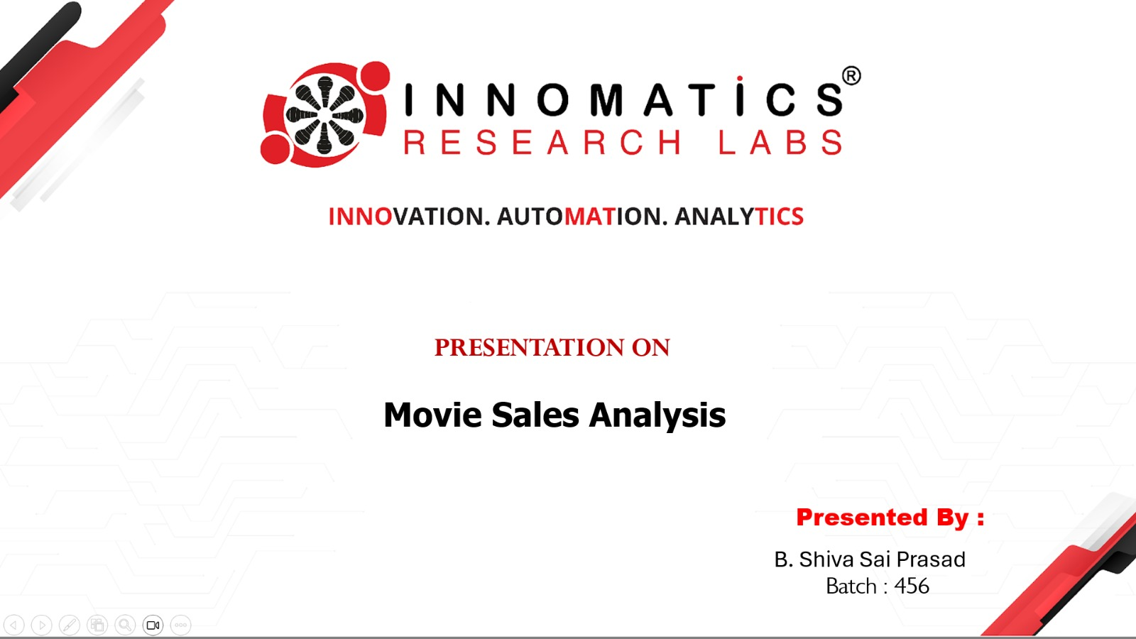





PROJECT ON

Slide 2
ABOUT ME
My Name Is B Shiva Sai Prasad.
I Completed Graduation B.Tech In Electronics And Communications Engineering.
I’ve Passion About Turning Raw Data Into Meaningful Insights.
My Linked In : Shiva sai Prasad | LinkedIn

Slide 3
Agenda
Project Introduction.
Business Problem & Objectives.
Dataset Overview.
Dashboard & Report Design.
Movie Overview & Time Trends.
Genre & Rating Analysis.
Top Performers & Box Office Insights.
Correlation & Advanced Metrics.
Conclusion.
Future Scope.

Slide 4
Project Introduction
Detailed Description:
            The Movie Industry Produces A Huge Amount Of Data Related To Movies, Ratings, And Audience Reviews.
            Imdb Is One Of The Largest Platforms Where Users Rate Movies Based On Their Viewing Experience.
In this project, Power BI is used to:
                Identify Patterns And Trends.
                Convert Raw Data Into Meaningful Visual Insights.

Slide 5
Business Problem
The Movie Industry Has Access To Large Amounts Of Data Related To Movie Releases, Genres, Ratings, Votes, And Box Office Revenue.
However, This Data Is Not Easily Understandable In Raw Form, Making It Difficult For Stakeholders To Identify Performance Trends And Key Success Factors.
This Power Bi Project Analyzes Movie Data To Understand Year-wise Trends, Genre Performance, Top Movies And Directors, And The Relationship Between Ratings, Votes, And Revenue, Enabling Data-driven Decision Making.

Slide 6
Dataset Overview
The Dataset Used In This Project Contains Detailed Information About Movies Collected From Imdb.
It Includes Attributes Such As Movie Title, Genre, Release Year, Imdb Rating, Number Of Audience Votes, Box Office Revenue, Runtime, Metascore, Director, And Actors.
This Dataset Helps Analyze Movie Performance Across Time, Genres, Audience Engagement, And Revenue Using Power Bi.
Sales Are Influenced By Budget, Star Cast, Marketing, And Audience Ratings.

Slide 7
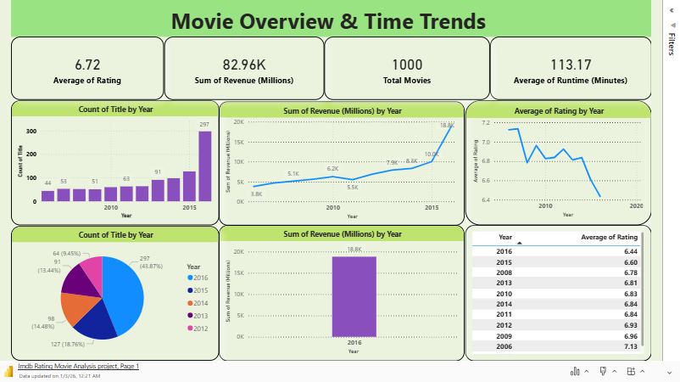

Slide 8
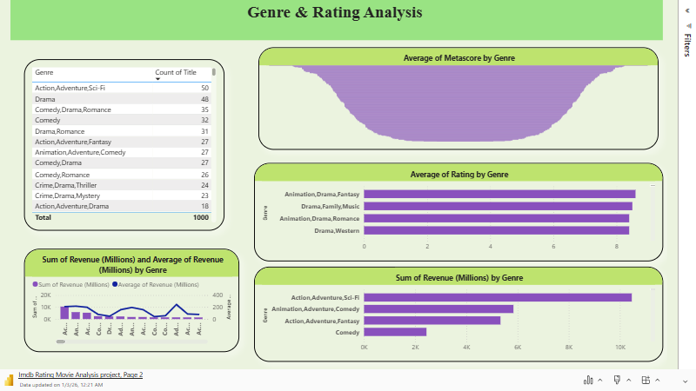

Slide 9
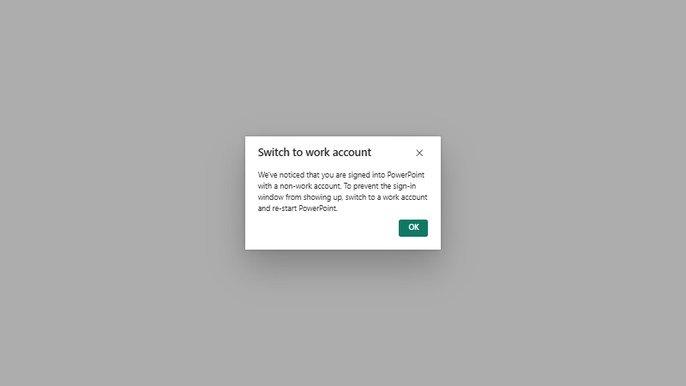

Slide 10


Slide 11
Conclusion
Raw Imdb Movie Data Was Successfully Transformed Into Meaningful Insights Using Power BI .
Year-wise Analysis Helped Identify Trends In Movie Releases, Ratings, And Revenue.
Genre-wise Analysis Revealed Differences In Audience Preference And Financial Performance.
Audience Engagement (Votes) And Ratings Were Found To Influence Box Office Revenue.
Top-performing Movies And Directors Were Identified Using Interactive Visuals.
Overall, The Analysis Supports Data-driven Decision Making In The Movie Industry.

Slide 12
Future Scope
Integrate Additional Data Such As Box Office, OTT, And Regional Performance.
Apply Predictive Analysis To Forecast Ratings And Revenue.
Develop Advanced Dax Measures For Deeper Insights.
Expand Analysis To Actor- And Director-level Performance.
Automate Data Refresh With Live Data Connections.
Enhance Dashboards With Advanced Visuals And Drill-through Features.

Slide 13

Any Questions ??

Slide 14


